Slide 1
Astro 331 Lesson 5
Orbit and Constellation Design
SMAD Ch 7

Slide 2
Lesson Objectives
Describe the different orbits used throughout a spacecraft’s mission lifetime
Name commonly used mission orbits, describe their characteristics, and identify common missions that use those orbits
Describe the tradeoffs between performing a mission using a single satellite versus a constellation of satellites
Describe factors influencing the development of a spacecraft constellation
Define spacecraft orbital elements for a Walker Delta Pattern constellation and vice versa

Slide 3
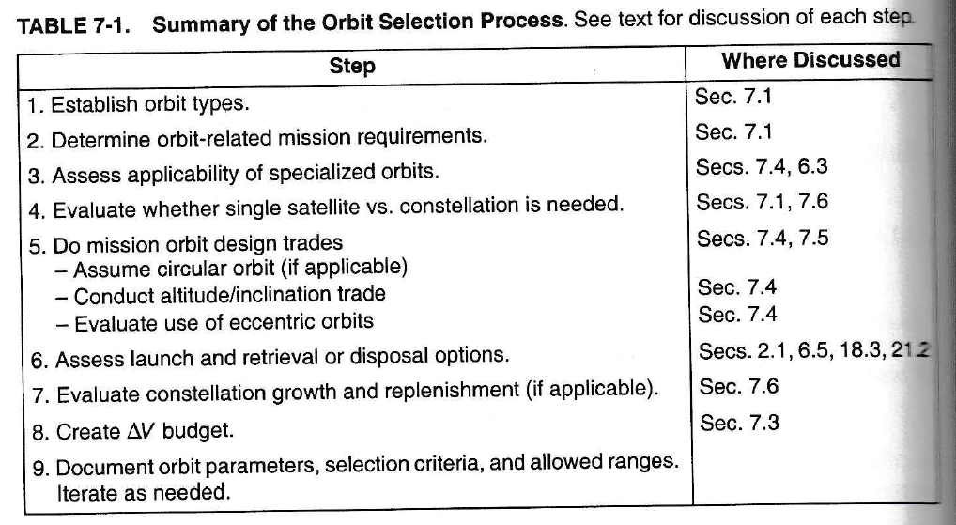
Orbit & Constellation Design Process
Insert Table 7-1

Slide 4
Step 1: Establish Orbit Types
There are different orbits needed at different times during mission lifetime
Parking orbit: safe & convenient temporary orbit for S/C checkout
Transfer orbit
Operational orbit
earth-based: coverage of Earth’s surface or near-Earth space (ex GEO, LEO. etc)
space-referenced: principal characteristic is a specific location in space (ex Lagrange points)
Disposal orbit

Slide 5
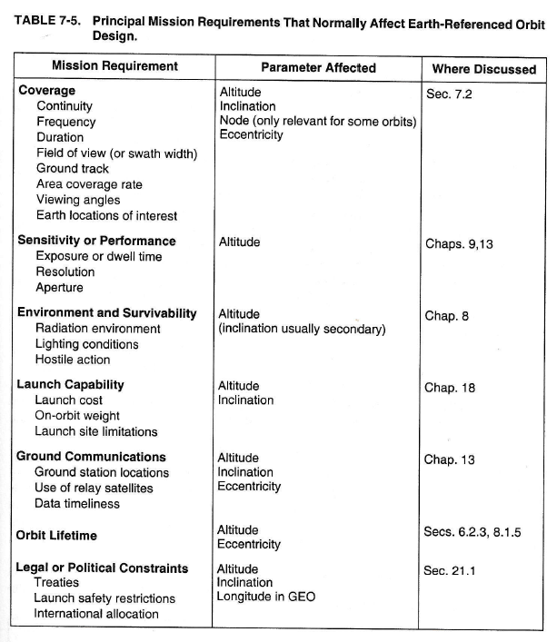
Step 2: Determine Orbit-Related Mission Reqts

Slide 6
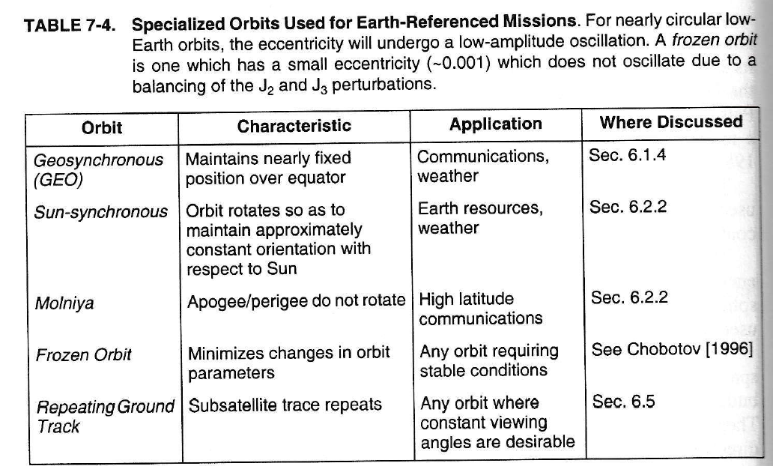
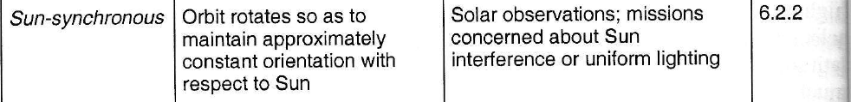
Step 3: Assess Standard Orbits
From Table 7-8

Slide 7
What is a satellite constellation?

Slide 8
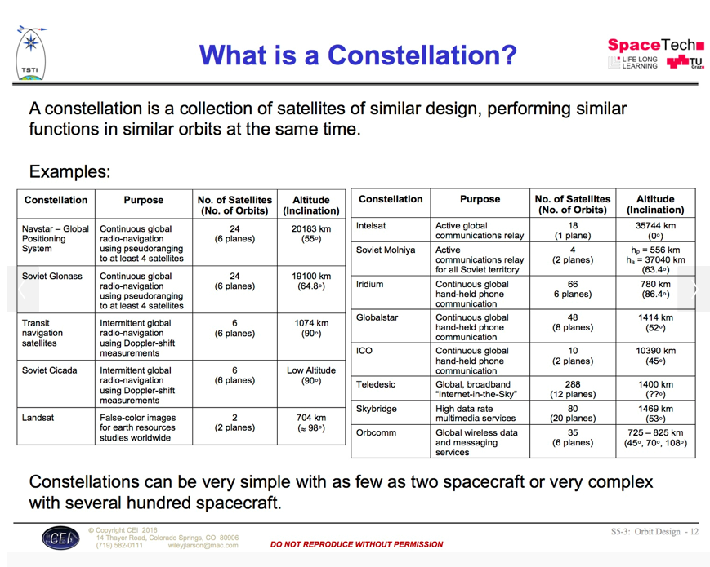
Designing Space Missions and Systems, Presentation Slide S5-3: Orbit Design - 12

Slide 9
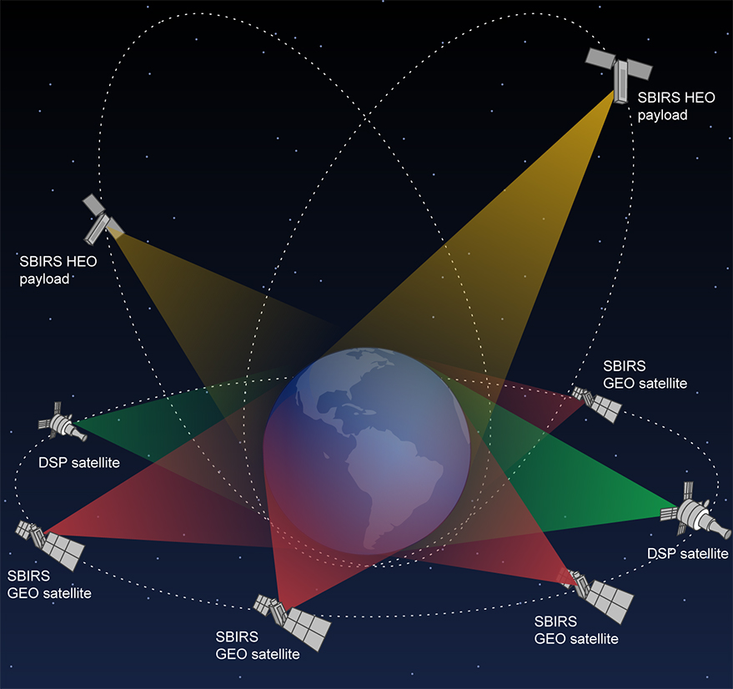
Notes:
SBIRS constellation

Slide 10
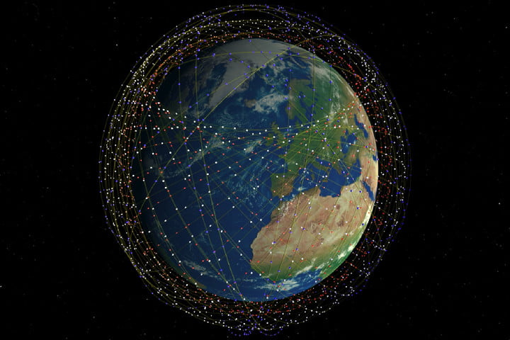
Notes:
Starlink constellation

Slide 11
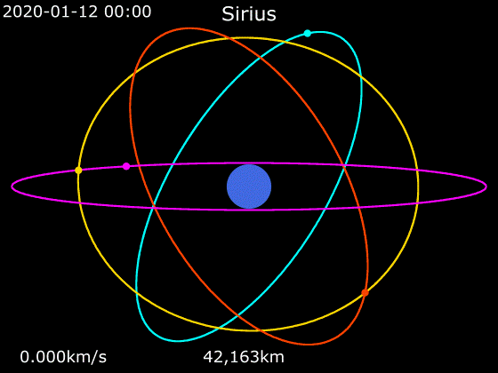
Notes:
Sirius XM radio

Slide 12
Step 4: Single Satellite vs Constellation
key trade is usually single, large S/C w/complex instruments vs constellation of smaller, simpler S/C
single S/C reduces cost by minimizing mission overhead
constellations provide
better temporal or spatial coverage
more robust comm links
on-orbit spares offer higher system reliability if a S/C is lost
more survivability
multiple environmental conditions or geometries to carry out mission
Consider principal factors in designing a constellation (Table 7-10)

Slide 13
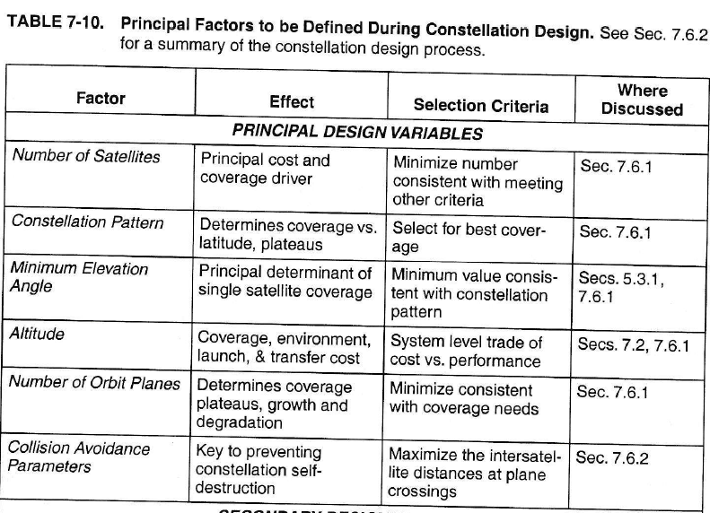
Principal Factors to Consider
Insert Table 7-10

Slide 14
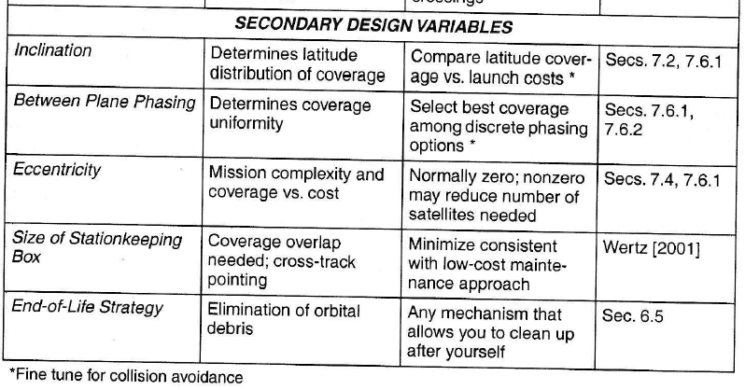
Insert Table 7-10
Constellation options
Walker Delta
Two-Plane Polar
Three mutually perpendicular planes
Two perpendicular non-polar planes
Five-plane polar “streets of coverage”

Slide 15
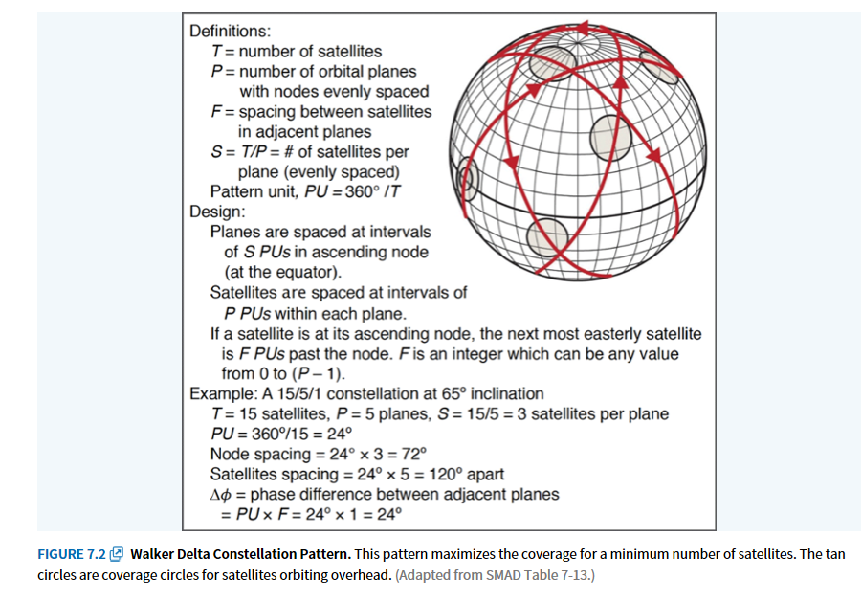
Walker Delta Constellation

Slide 16
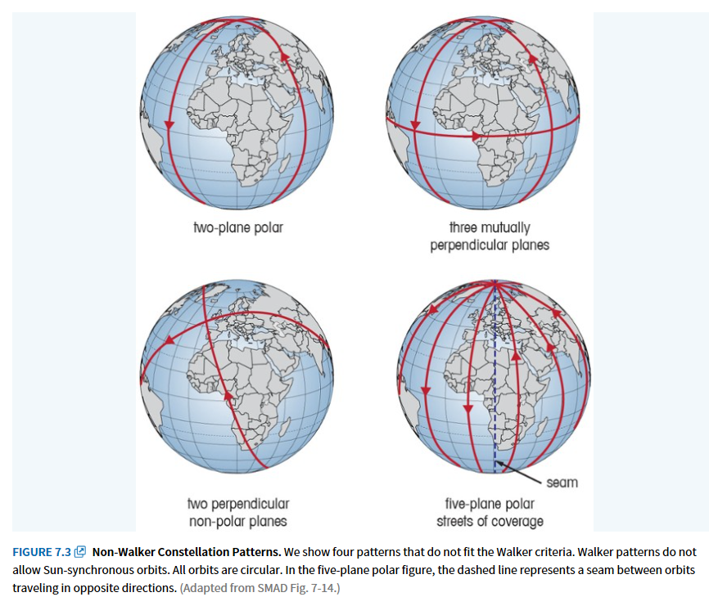
Fig 7-14 in SMAD

Slide 17
Step 5: Perform Mission Design Trades
Footprint area (F_{A} or FOV area)
area that a specific instrument or antenna can see at any instant
Instantaneous access area (IAA)
all the area that an instrument or antenna could potentially see at any instant if it were scanned through its normal range of orientations
Area coverage rate (ACR)
the rate at which the instrument or antenna is sensing or accessing new land
Area access rate (AAR)
the rate at which new land is coming into the spacecraft’s access area

Slide 18
Coverage Figures of Merit
Percent coverage
# of times a point was covered by one or more satellites divided by the total number of simulation time steps
Maximum coverage gap
The longest coverage gap of an individual point
Mean coverage gap
Average length of breaks in coverage for a given point on a grid
Time average gap
Mean gap duration averaged over time
Mean response time
Average time from receipt of a request to observe a particular point until we can observe it

Slide 19
Constellation Design Issues
coverage (look at coverage (performance) vs number of S/C (cost))
maneuvers
avoid switching orbital planes
limit number of planes to limit number of launches
rephasing S/C w/in orbital plane uses very little propellant
number of orbit planes
#planes determines #times a given surface area can be accesses
#S/C in a plane determine gaps in coverage
plateaus and degradation
each additional S/C adds performance
graceful degradation means if one S/C fails, remaining S/C provide needed service at reduced level rather than total loss of service
use computer modeling to assess performance
launch vehicle selection
try to match #orbit planes and S/C in each plane to number of S/C that can be launched on one L/V
reasonable to begin constellation design assuming all S/C in circular orbits at same altitude and inclination

Slide 20
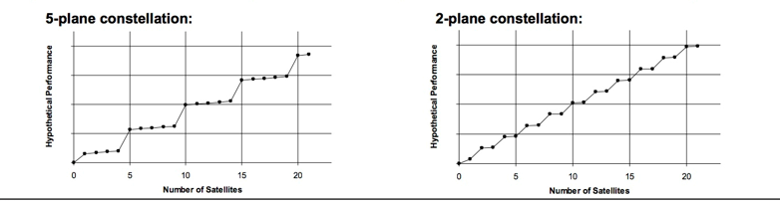
Performance Plateaus
Designing Space Missions and Systems, Presentation Slide S5-3: Orbit Design - 16

Slide 21
Step 6: Assess Orbital Transfer, Launch, and Retrieval/Disposal Options Step 7: Evaluate Constellation Growth and Satellite Replenishment
often requires numerical solns to evaluate coverage Figures of Merit
performance tends to come in plateaus (flip side is graceful degradation)
generally some performance benefit with first S/C
major performance plateau may not occur next until plane is populated or each plane has at least one S/C

Slide 22
Step 8: Create a ΔV Budget Step 9: Iterate & Document
Account for ΔVs needed
Think perturbations, station-keeping, momentum dumping, etc

Slide 23
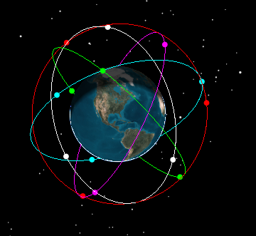
Example: Walker-Delta Constellation
Example: 15/5/2 Walker Delta Constellation
Given: COEs for 1st S/C:
a = X km
e = 0
i = Y deg
Ω = 10 deg
u = 0 deg
Find: COEs for remaining S/C in constellation

Slide 24
Solution
 | Orbit Plane
a (km)
e
i (deg)
Ω (deg)
u (deg)

